Slide 1
Student Mentorship and Guidance Management Portal
CSA 4302 Internet Programming
PROJECT GUIDE
Dr. Kosalairaman
Dheeraj Krushna P(192525230) CSE(AIML)
Srikanth(192411139) CSE
P. Hemanth Reddy(192311086) CSE(cs)

Slide 2
INTRODUCTION
The Student Mentorship and Guidance Management Portal is a centralized platform designed to connect students with mentors.
It helps students receive academic support, career guidance, and personalized learning recommendations.
The portal enables efficient mentor allocation, appointment scheduling, and communication between students and mentors.
It tracks student progress, collects feedback, and improves the overall mentorship and learning experience.

Slide 3
PROBLEM STATEMENT
Lack of Centralized Student Information: Student academic records, performance details, and learning goals are maintained separately, making progress tracking difficult.
Inefficient Mentor Allocation: Assigning suitable mentors to students and managing mentorship appointments can be time-consuming and unorganized.
Limited Guidance and Communication: Students may face difficulties accessing timely academic support, career guidance, and effective communication with mentors.
Inadequate Progress Monitoring: The absence of systematic feedback collection and progress reports makes it difficult to identify student challenges and measure improvement.

Slide 4
OBJECTIVES
Smart Matching: Pair by exact technical skills.
Unified Scheduling: Automate faculty availability blocks.
Progress Tracking: Monitor active milestone completion.

Slide 5
MODULES
Module 1:
Student Profile and Academic Progress Management
Module 2:
Mentor Allocation and Communication Management
Module 3:
Guidance, Feedback and Progress Monitoring

Slide 6
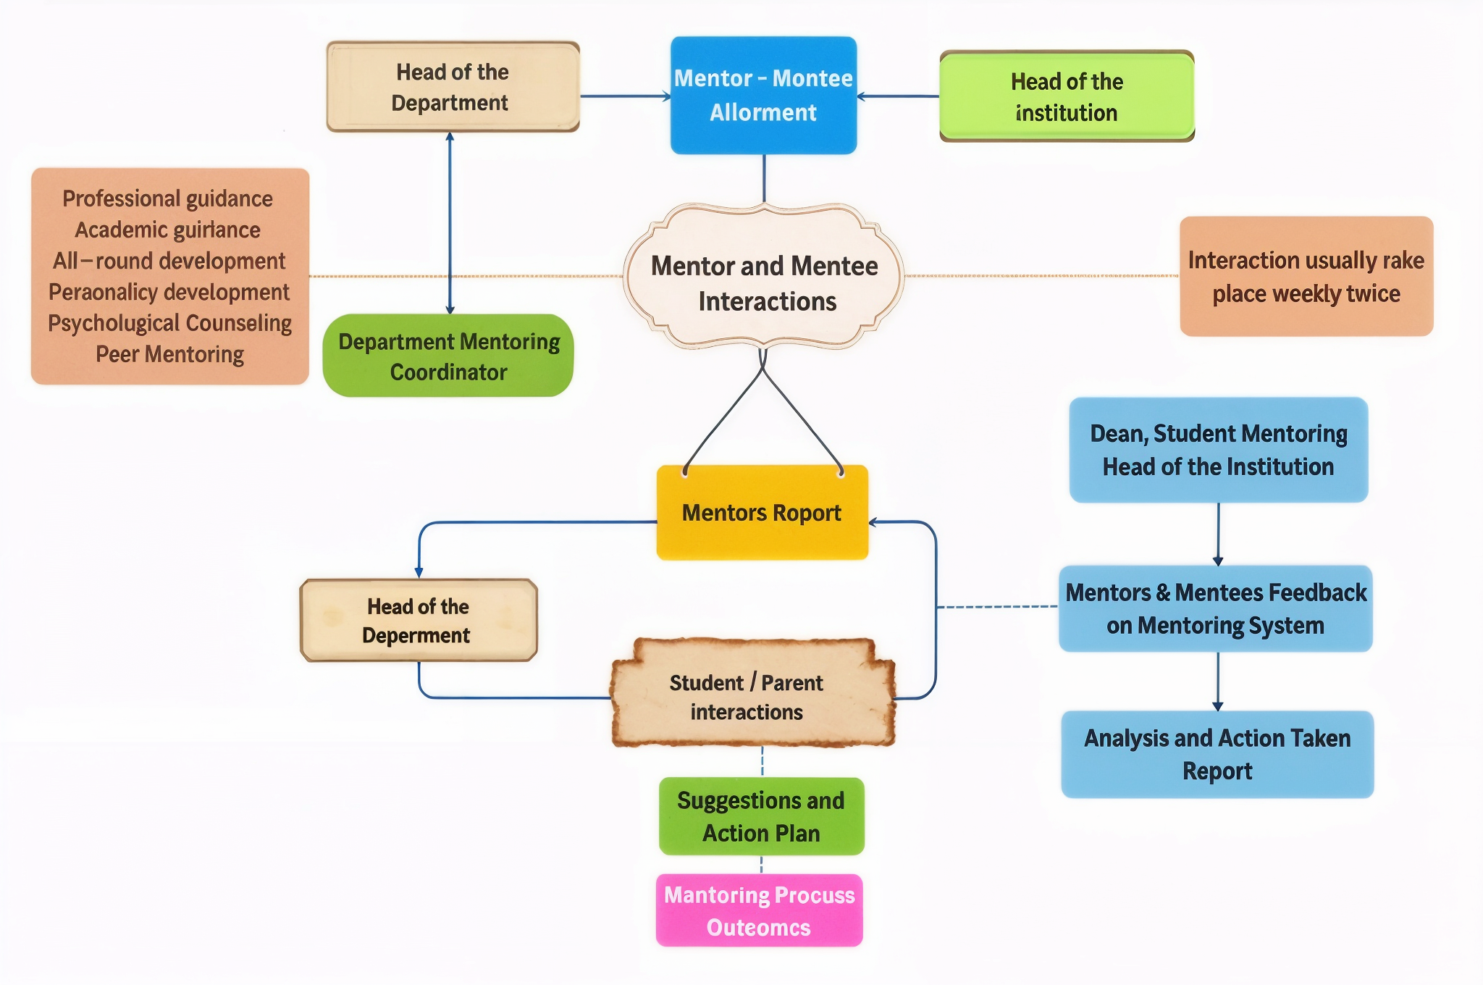
SYSTEM ARCHITECTURE

Slide 7
LITERATURE SURVEY
S.No | Research Paper | Year | Limitations
1 | Guided Student Profile System: Mentor Feedback Integration | 2024 | Limited personalized guidance and progress tracking.
2 | A Mentorship-Driven Decision Support Platform for Career Planning in Undergraduate Engineering Education | 2026 | Focuses mainly on career planning.
3 | Bridging the Gap: Developing an Alumni Association Platform to Enhance Student Guidance and Institutional Connectivity | 2025 | Limited focus on continuous academic mentoring.
4 | Enhancing Career Development: An AI-Driven Mentorship Platform for Student-Mentor Connections | 2025 | Primarily focuses on AI-based mentor connections.

Slide 8
REFERENCE
Sadasivam, V. R., Sanjaykumar, V., Imam, A. S., & Vasanthan, R. (2024). Guided Student Profile System: Mentor Feedback Integration. 2024 International Conference on Intelligent Systems for Cybersecurity (ISCS), IEEE, 1–5.
Dhumal, A. D. (2026). A Mentorship-Driven Decision Support Platform for Career Planning in Undergraduate Engineering Education.
Jaiswal, A., Solanki, P., Rathore, R., Pillai, S., Jain, S., Berchha, T., & Toke, V. (2025). Bridging the Gap: Developing an Alumni Association Platform to Enhance Student Guidance and Institutional Connectivity. International Journal of Knowledge Based Computer Systems, 13(1), 38.
Charanya, P., Nidhish, M., Prajesh, U. R., Saktheeswar, K., & Sanjana, S. P. (2025). Enhancing Career Development: An AI-Driven Mentorship Platform for Student-Mentor Connections. 2025 International Conference on Computational, Communication and Information Technology (ICCCIT), IEEE, 147–152.

Slide 9
THANK YOU!

